Slide 1
COMPONENTS
"React abstracts away the DOM from you, giving a simpler programming model and better performance."

Slide 2
Props
props :
read only properties in react used in components to update UI
prop is used to define a component that can take arguments via the component's HTML element attributes.
props are immutable and not dynamic. To change the value of a prop requires re-rendering the component.

Slide 3
state
state : used to mutate the component state to reflect changes in DOM. React component’s state allows for dynamic behavior.
Note :
this.setState() method will merge the existing this.state with the object that is passed in.

Slide 4
Props vs state
Props are immutable.
Props should not be updated by the component to which they are passed.
Props are owned by the component which passes them to some other component.
State is internal and private to the component.
State can and will change depending on the interactions with the outer world. (Avoid state as far as possible)
State should store as simple data as possible, such as whether an input checkbox is checked or not or a CSS class that hides or displays the component.
Use props for static data and state for dynamic data

Slide 5
Props and state
When do you use props or state, or even just private variables?
Props are used for passing data between parent and child React classes, and any changes to a prop cause an automatic re-render of the view, both parent and child.
For data that’s relevant only to the view and nothing else, use state. Any changes here also rerender the view.
For any data that’s pertinent to the class but not the view itself, you could use a private variable

Slide 6
Components and Component Life cycle

Slide 7
Components
Object oriented widgets definition
Nested widgets support
HTML like widget DOM definition (Virtual DOM)
State spreading to nested components-
ONE WAY REACTIVE DATA FLOW
Optimized rendering to the real DOM tree

Slide 8
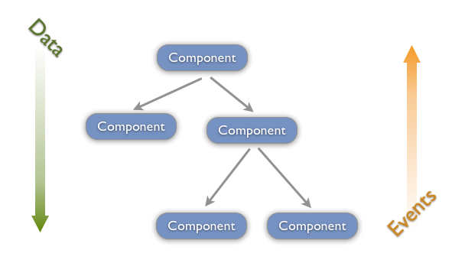
Data Flow

Slide 9
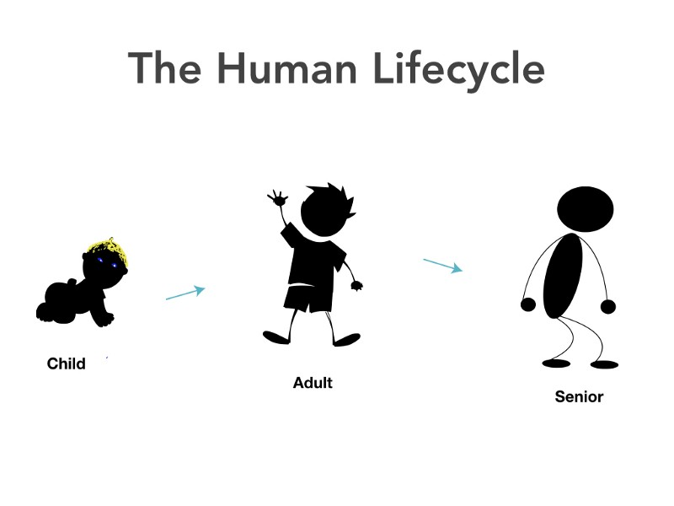
Components

Slide 10
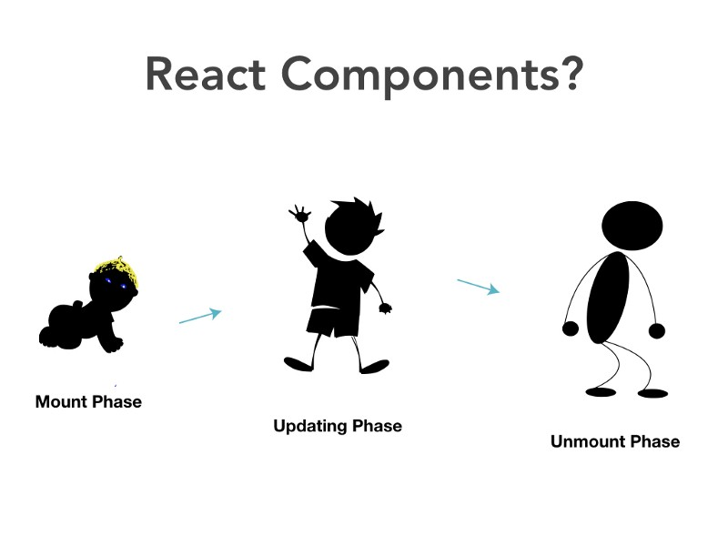
Components

Slide 11
Components
Five phases of a React component
Initialization (initializing the state in constructor)
Mounting
Update
Unmounting
Error Handling

Slide 12
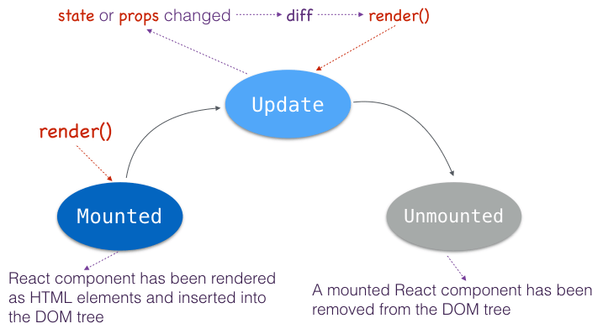
Components
ERROR HANDLING
(SICK)
BIRTH
GROWTH
DEATH

Slide 13
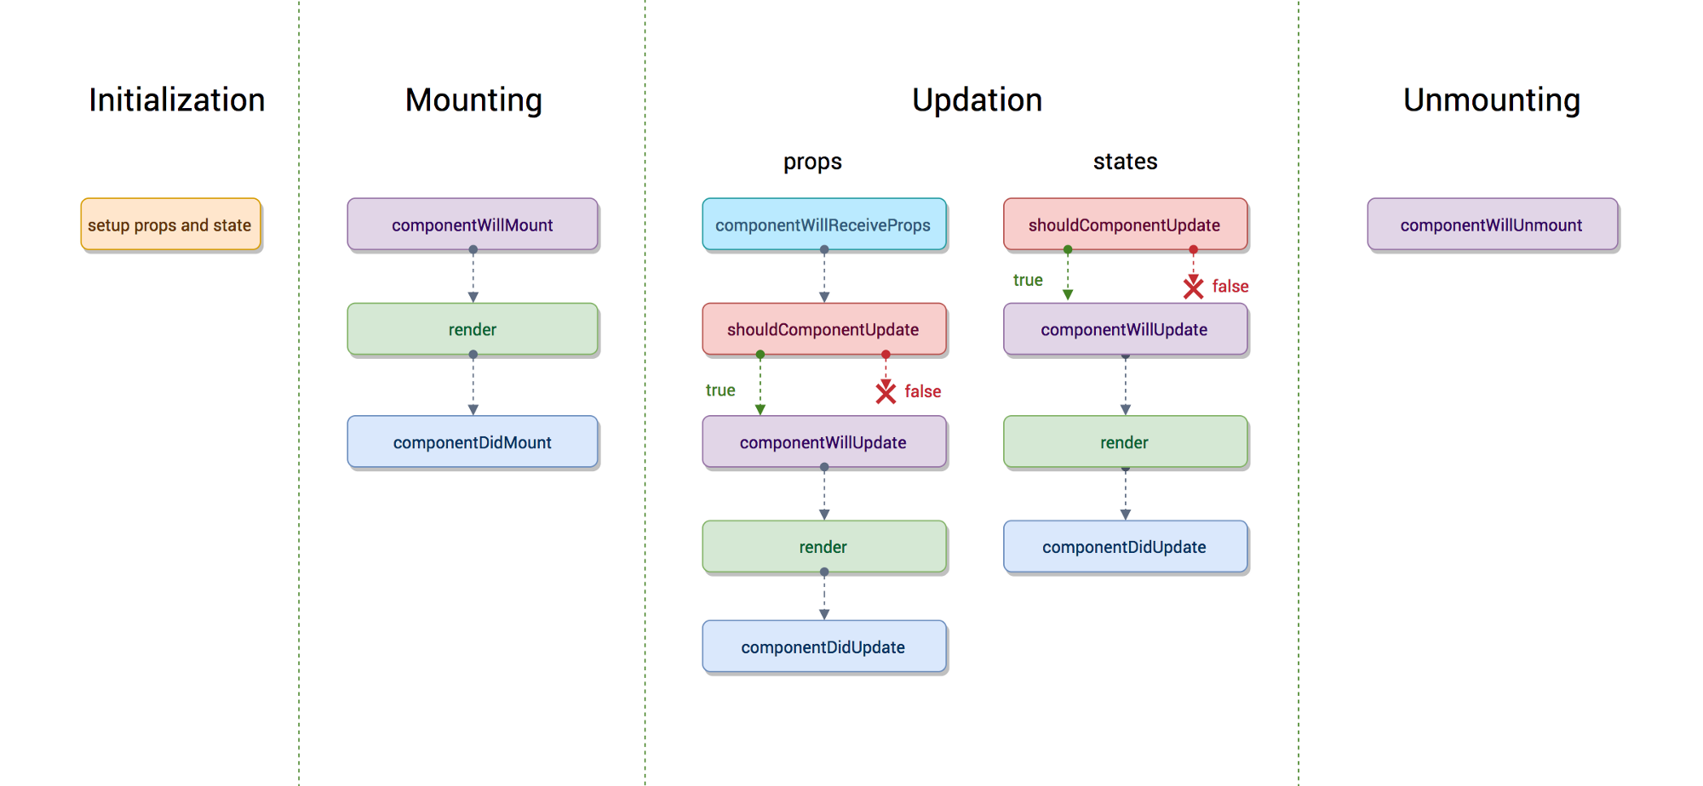
Components

Slide 14
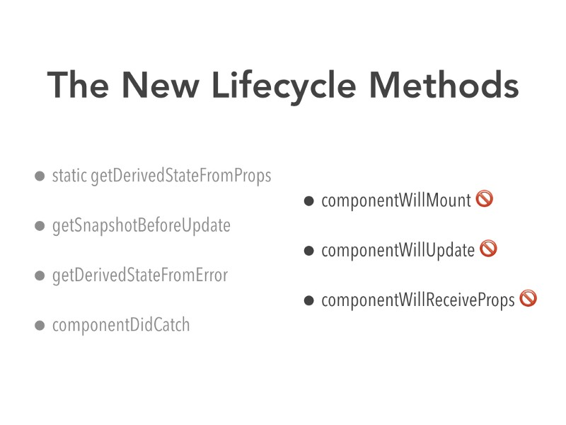
Components

Slide 15
Components
1. Mounting
constructor(), getDerivedStateFromProps(), render() and componentDidMount()
2. Updating
getDerivedStateFromProps(), shouldComponentUpdate(),
render(), getSnapshotBeforeUpdate() and componentDidUpdate()
3. Unmouting
componentWillUnmount()
4. Error handling
componentDidCatch()

Slide 16
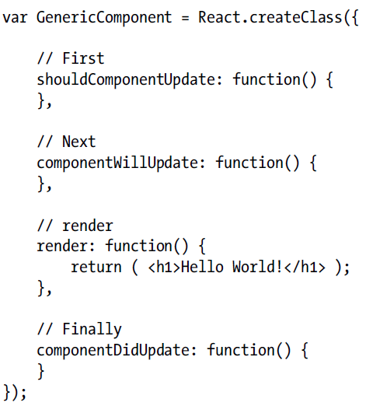
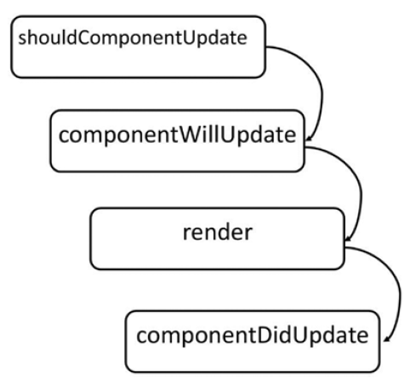
Life cycle during Change of State

Slide 17
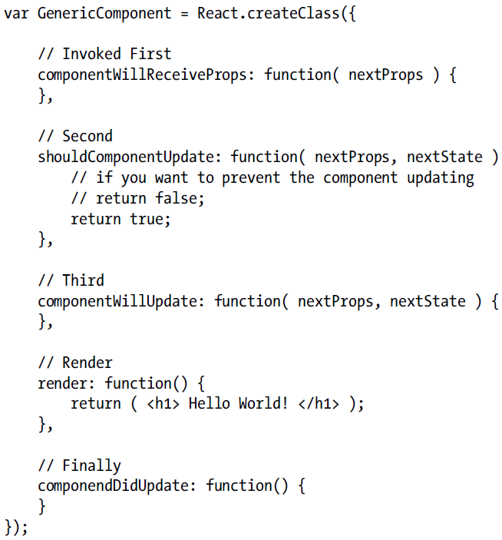
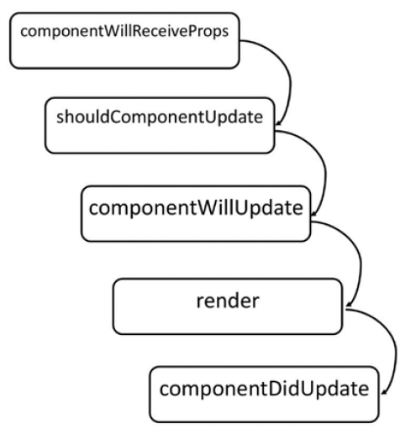
Life cycle during prop changes

Slide 18
React
Unmounted state happens when we explicitly call React.unmountAndReleaseReactRootNode() or automatically if a component was a child that was no longer generated in a render() call.
Most often you don't have to deal with this and just let React do the proper thing.

Slide 19
React – Controlled Component
An <input> with value set is a controlled component. In a controlled <input>, the value of the rendered element will always reflect the value prop.
render: function() {
return <input type="text" value="Hello!" />;
}
This will render an input that always has a value of Hello!.
Any user input will have no effect on the rendered element because React has declared the value to be Hello!.

Slide 20
React – Controlled Component
To update the value in response to user input, use the onChange event:
getInitialState: function() {
return {value: 'Hello!'}; },
handleChange: function(event) {
this.setState({value: event.target.value});
}, render: function() {
var value = this.state.value;
return <input type="text" value={value} onChange={this.handleChange} />;
}

Slide 21
React – Controlled Component
Here we are accepting the newest value provided by the user and updating the value prop of the <input> component.
This pattern makes it easy to implement interfaces that respond to or validate user interactions.
For example:
handleChange: function(event) {
this.setState({value: event.target.value.substr(0, 140)});
}
This would accept user input but truncate the value to the first 140 characters.
.

Slide 22
React – Controlled Component
Why Controlled Components?
Using form components such as <input> in React presents a challenge that is absent when writing traditional form HTML.
For example, in HTML:
<input type="text" name="title" value="Untitled" />
This renders an input initialized with the value, Untitled. When the user updates the input, the node's value property will change.
However, node.getAttribute('value') will still return the value used at initialization time, Untitled.

Slide 23
React – Controlled Component
Unlike HTML, React components must represent the state of the view at any point in time and not only at initialization time.
For example, in React:
render: function() {
return <input type="text" name="title" value="Untitled" />; }
Since this method describes the view at any point in time, the value of the text input should always be Untitled..

Slide 24
React – Uncontrolled Component
Uncontrolled Components
An <input> that does not supply a value (or sets it to null) is an uncontrolled component.
render: function() { return <input type="text" />; }
.

Slide 25
React
Default Value
To initialize the component with a non-empty value, supply a defaultValue prop.
render: function() {
return <input type="text" defaultValue="Hello!" />; }
This example will function much like the Controlled Components
<input> supports defaultChecked
<select> supports defaultValue.
.

Slide 26
React – ref
The ref String Attribute
React supports a very special property that can be attached to any component that is output from render().
This special property allows to refer to the corresponding backing instance of anything returned from render(). It is always guaranteed to be the proper instance, at any point in time.

Slide 27
React – ref
The ref String Attribute
Assign a ref attribute to anything returned from render such as:
<input ref="myInput" /> In some other code (typically event handler code), access the backing instance via this.refs as in:
this.refs.myInput : can access the component's DOM node directly
React.findDOMNode(this.refs.myInput).

Slide 28
React – ref
The ref String Attribute
render: function() {
return (
<TextInput
ref={function(input) {
if (input != null) {
input.focus();
}
}} />
);
}, (refddemo.html)

Slide 29
React - ref
create the intermediate-DOM in render(), to assign a ref property to a child component then refer to it from the parent using the refs property.
render: function(){ // Set a ref
return (
<div> <span ref="counter"
class="count">{this.state.count}</span> </div>;
)}
handleMouseDown: function(){ // Use the ref console.log(this.refs.counter.innerHTML);
},

Slide 30
React - ref
The ref Callback Attribute
The ref attribute can be a callback function instead of a name.
This callback will be executed immediately after the component is mounted.
The referenced component will be passed in as a parameter, and the callback function may use the component immediately, or save the reference for future use (or both).

